Slide 1

STARDUCKS
STARDUCKS
The Rising Star of The Cafe World
Business Data Analysis of Starducks

Slide 2


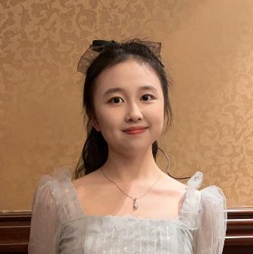

Presenters
Jiang Zheng
119010128
Wang Muying
119010301
Ning Xinyue
121090423
Liu Simeng
119010196
Sales & customer analysis
25% contributed
Product promotion analysis & optimization
25% contributed
Product & store analysis
25% contributed
Employee analysis & optimization
25% contributed

Slide 3


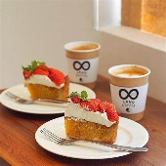
CATALOGUE
Background Information
1
5 basic information about StarDucks from 2017 to 2019
Issues and Solutions
2
A closer look at some problems
Conclusions
3
Conclusions and further discussion

Slide 4
Background Information
5 basic information about StarDucks from 2017 to 2019

Slide 5
Issues and Solutions
A closer look

Slide 6
Issue 1:
Limited Promotion on Sales

Slide 7

Solution 1: More Promotion
More advertisement and promotion events.
Pay attention to the return rate of each promotion campaign.

Slide 8
Solution 2: Marketing on Old Customer
Customers since 2017 contribute most to the sales.
Do marketing targeting on our old customers.
Incentive on sales.
Increase customer retention rate.

Slide 9
Issue 2:
Unbalanced Profit Margin and Sales for Bakery & Loose Tea

Slide 10
Solution 1: Mark Up for Bakery & Mark Down for Loose Tea
Room for price adjustment due to:
High profit margin for loose tea
Relatively high sales for bakery

Slide 11
Solution 2: Product Combination Sale
Make it a combo!
A set with a better price than a la carte is fascinating to customers.
Increase sales
Attract new customers

Slide 12
Issue 3: Low sales of some coffee wranglers, especially old employees
AVG
Standing in 2019, define employees who start working in the coffee shop before 2015/1/1 as old employees, and others (who start working in the coffee shop after 2015/1/1) as new employees.
Among all coffee wranglers who had much smaller accumulated sales from 2017 to 2019, 75% of them are old employees while 25% of them are new employees.
Staff ID Start working date
7 2003/10/18
19 2014/3/12
18 2005/11/13
9 2013/9/9
8 2005/2/9
25 2017/3/14
10 2016/12/10
13 2009/12/11

Slide 13
Solution 1: Strengthen employee training
Frequent employee training should be conducted to help employees get more familiar with available products in the coffee shop.
Solution 2: Bonus & Penalty Motivation System
KPI assessment of employees’ sales should be implemented at the end of each month.
BONUS
PENALTY
If the monthly sales of old employees rank in the bottom 10% of the total number of employees for
two consecutive months, their annual bonus will be reduced.
four consecutive months, they will be given a warning of dismissal.
If the monthly sales of employees rank in the top 10% of the total number of employees for two consecutive months, the annual bonus will be increased as an incentive.

Slide 14
Conclusions
Conclusions and further discussion

Slide 15
Conclusion
Sales
Sales Trend
Steadily increase from 2017 to 2019
Serge since March, especially in 2019
Marketing and Management Problems
Business Reflective
Cycle
Promotion
Product management
Employee management
Future Direction
Marketing
Management
Sales, management, and marketing
Seize the chance of increase in April

Slide 16
THANK YOU
THANK YOU

